Slide 1
HIST 111: United States History to 1865
Second Review Powerpoint

Slide 2
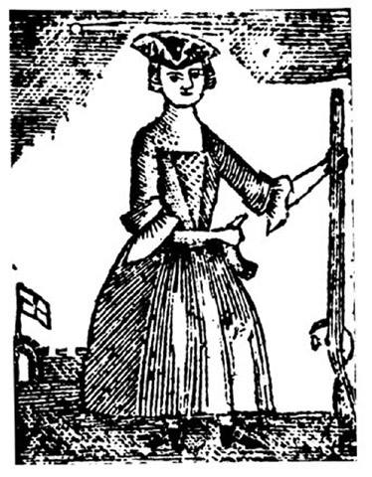
Review
Depiction of the Daughters of Liberty, a group of women who protested British restrictions through nonconsummation. In many towns, young women calling themselves Daughters of Liberty met to spin in public squares to try to persuade other women to make homespun and to encourage colonists dependence on British cloth.
Daughters of Liberty
Virtual Representation
According to the theory of virtual representation, all Britons—including colonists—were represented in Parliament. Thus their consent to acts of Parliament could be presumed. In the colonies, by contrast, members of the lower houses of the assemblies were viewed as specifically representing the regions that had elected them.
The Intolerable Acts, was the colonial name given to the Coercive and Quebec Acts of 1774.
Coercive Acts (1774): First the Boston Port Act closed the port of Boston to all trade until local citizens would agree to pay for the lost tea (they would not). Secondly, the Massachusetts Governmental Act greatly increased the power of the Massachusetts’ royal governor at the expense of the legislature. Thirdly, the Administration of Justice Act provided that royal officials accused of crimes in Massachusetts could be tried elsewhere, where chances of acquittal might be greater. Finally, a strengthened Quartering Act allowed the new governor, General Thomas Gage, to quarter his troops anywhere, including unoccupied private homes.
Quebec Act (1774), which extended the province of Quebec to the Ohio River, established Roman Catholicism as Quebec’s official religion, and set up for Quebec a government without representative assembly.
The Intolerable Acts (short-answer forma)

Slide 3
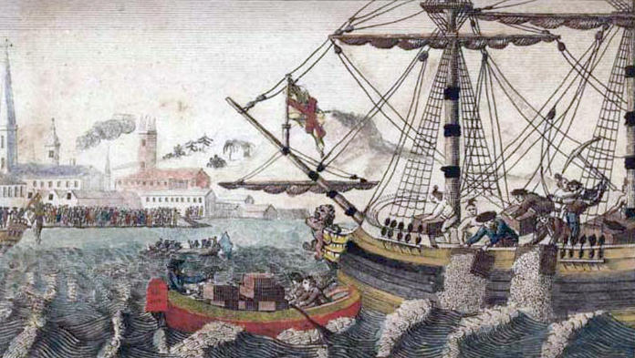
Review
Identify the following image and give the larger significance:
Depiction of the Boston Tea Party, which occurred on December 16, 1773. Bostonians, thinly disguised as Indians boarded the ships carrying British East India Co tea and threw the tea into the harbor to protest the Tea tax. Many Americans felt the destruction of private property was going to far, but the restrictions of the retaliatory Coercive Acts, caused many Americans to support Boston in opposition to Britain. This painting, a post revolutionary creation, depicts a crowd of future Americans viewing the Tea Party in ample light. It is designed to communicate patriotic memory not exactly depict the historical event.

Slide 4
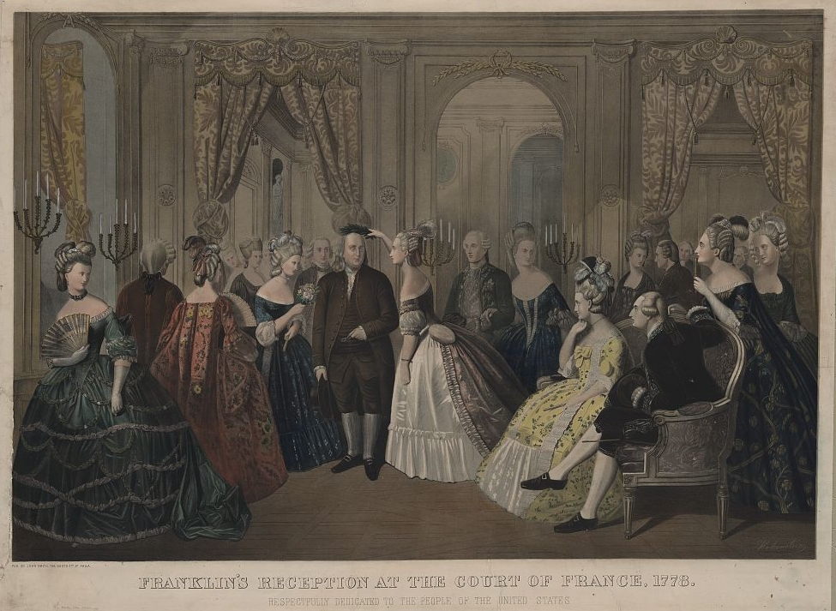
Review
Despite the overwhelming British victory in the Seven Years War, Nova Scotians believed themselves vulnerable to French counterattack and eagerly sought regular troops and naval vessels stationed within their borders. Additionally, sugar planters—on some islands outnumbered by their bondspeople twenty-five to one—feared the potential for slave revolts in the absence of British troops. Neither region had a large population of European descent, nor were local political structures very strong.
Explain why Nova Scotia and the West Indies sided with Britain
The patriots directed that quote to Indian communities that they hoped would remain neutral. Yet warfare between settlers and Indians persisted in the backcountry long after fighting between patriot and redcoat armies had ceased. Indeed, the Revolutionary War itself constituted a brief chapter in the ongoing struggle for control of the region west of the Appalachians, which began in 1763 and continued into the next century.
To whom did the Patriots describe the Revolutionary conflict as “a family quarrel between us and Old England.”
Dunmore’s Proclamation (short answer format)
On November 7, 1775 John Murray, the Earl of Dunmore, issued what became known as Dunmore’s Proclamation which offered freedom to all “indentured Servants, Negroes, or others, (appertaining to Rebels)…able and willing to bear Arms” for the British. Dunmore’s Proclamation triggered a mass exodus of fugitive slaves who escaped their plantations by crossing British lines.
Black refugees were entitled to a “certificate of freedom” for their work but received few other benefits and often had to provide food and shelter for themselves. Thousands escaped slavery only to die of smallpox and what contemporaries called “camp fever,” which was likely typhus.

Slide 5
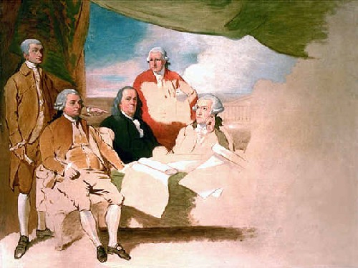
Review
Identify the following image and give the larger significance:
Benjamin West’s painting of the delegations at the Treaty of Paris (1783): John Jay, John Adams, Benjamin Franklin, Henry Laurens, and William Temple Franklin. The British delegation refused to pose so the painting was never finished

Slide 6
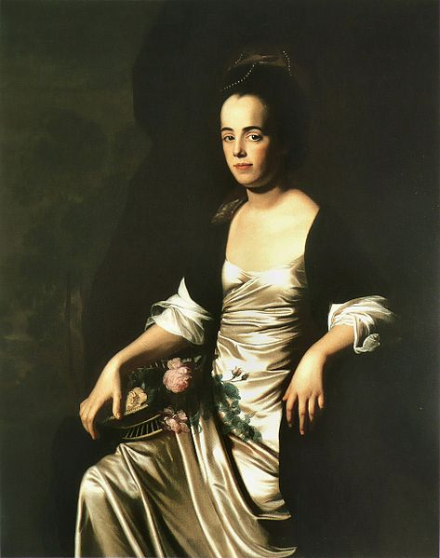
Review
First, some northern states began to use tax money to support public elementary schools. In 1789 Massachusetts became one of the first states to require towns to offer their citizens free public elementary education.
Second, schooling for girls was improved. Recognizing the importance of the rising generation led Americans to conclude that mothers would have to be properly educated if they were to instruct their children adequately.
Name two educational reform measures enacted during the early republic
The ordinance prevented slavery by taking deep root by discouraging slaveholders from moving into the territory with slaves. But not until 1848 was enslavement abolished throughout the Old Northwest. And by omission Congress implied that slavery was legal in the territories south of the Ohio River. The ordinance of 1787 also specified the process by which territorial residents could organize state governments and seek admission to the Union.
Northwest Ordinance
The Articles did not give the national government the ability to raise revenue effectively or to enforce a uniform commercial policy.
The Articles required unanimous consent of state legislature for ratification or amendment and a clause concerning western lands proved troublesome.
The unicameral legislature was too inefficient and unwieldy to govern effectively.
List some limitations of the Articles of Confederation
John Singleton Copley’s Portrait of Mrs. John Stevens (Judith Sargent, later Mrs. John Murray) (1770-1772)

Slide 7
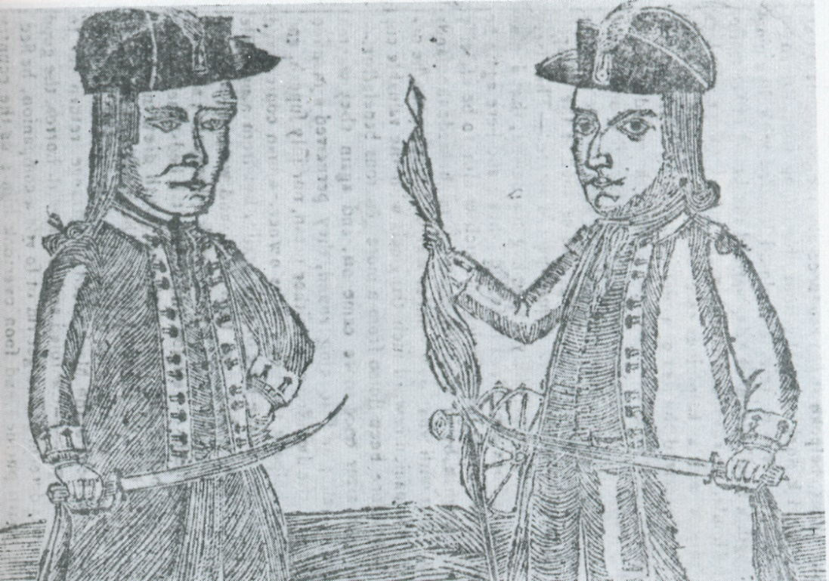
Review
Identify the following image and give the larger significance:
The portraits of Daniel Shays and Job Shattuck, leaders of the Massachusetts "Regulators.” Daniel Shays, a former officer in the Continental Army, assumed nominal leadership of the disgruntled westerners. On January 25, 1787, Daniel Shays, a former officer in the Continental Army, led about fifteen hundred troops in an assault on the federal armory at Springfield, attempting to capture the military stores housed there. Shays and some of his associates, fled the state, never to return; two were hanged; and most escaped punishment by paying small fines and taking oaths of allegiance to Massachusetts. The state legislature, for its part, soon dramatically reduced the burden on landowners by enacting new import duties and by easing tax collections.

Slide 8
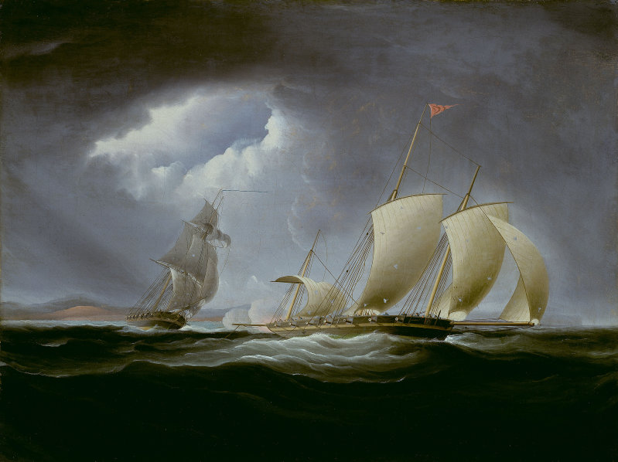
Review
After New England inventor Eli Whitney designed a cotton gin in 1793, allowing one person to remove the same number of seeds that previously required fifty people, cultivation of short-staple cotton spread rapidly into Louisiana, Mississippi, Alabama, Arkansas, and Tennessee. The cotton gin greatly increased the demand for slaves who seeded, tended, and harvested cotton fields.
cotton gin
Explain the larger significance of the burning of Washington during the War of 1812.
The British burned Washington DC in retribution for the Americans razing and burning the Canadian capital of York at the Battle of the Thames (which resulted in the death of Tecumseh). The British intended the attack on Washington as a diversion. The major battle occurred in September 1814 at Baltimore, where Americans held firm. Francis Scott Key, detained on a British ship, watched the bombardment of Fort McHenry and later wrote “the Star-Spangled Banner”
First Barbary War
After two years of stalemate, Jefferson declared a blockade of Tripoli, but when the American frigate Philadelphia ran aground in the harbor, its three hundred officers and sailors were imprisoned. Jefferson refused to ransom them, and a small American force accompanied by Arab, Greek, and African mercenaries marched from Egypt to the “shores of Tripoli” to seize the port of Derne.
A treaty ended the war in 1805, but the United States continued to pay tribute to the three other Barbary states— Algiers, Morocco, and Tunis—until 1815.
Capture of the Tripoli by the Enterprise off Malta August 1803. Thomas Birch, 1806.

Slide 9
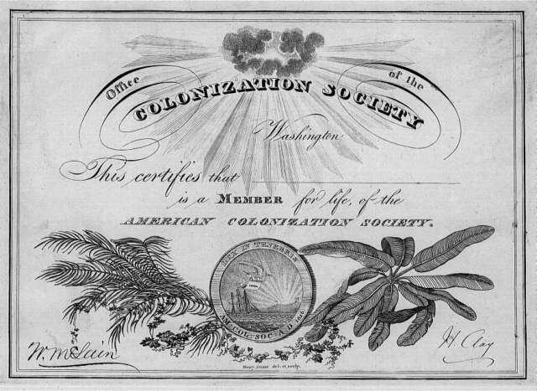
Review
Identify the following image and give the larger significance:
Elites often supported the colonization movement, which crystallized in 1816 with the organization of the American Colonization Society. Its members planned to purchase and relocate American slaves and free blacks to Africa or the Caribbean. Supporters included Thomas Jefferson, James Madison, James Monroe, and Henry Clay. In 1824, the society founded Liberia, on Africa’s west coast, and began a settlement for African Americans who were willing to go. The society had resettled nearly twelve thousand by 1860. Some colonizationists aimed to strengthen slavery by ridding the South of troublesome slaves or to purge the North of African Americans altogether. Others hoped colonization would improve African Americans’ conditions. Although some African Americans supported the movement, black abolitionists generally denounced it.

Slide 10
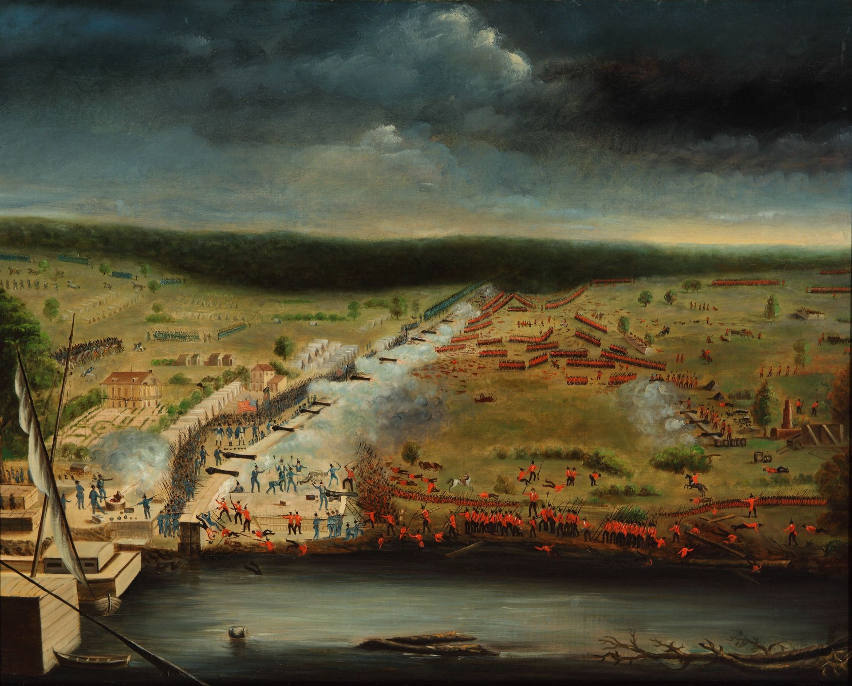
Review
The Battle of New Orleans occurred two weeks after the war’s conclusion: word had not yet reached America that British and United States diplomats had signed the Treaty of Ghent on December 24, 1814. Still, the Battle of New Orleans catapulted General Andrew Jackson to national political prominence.
The Battle of New Orleans
Name two long term effects of the War of 1812.
The War of 1812 affirmed the independence of the American republic and ensured Canada’s independence from the United States. Trade and territorial disputes with Great Britain continued, but they never again led to war.
The Missouri Compromise
The compromise worked out by House Speaker Henry Clay in 1820 established a formula that avoided debate over whether new states would allow or prohibit slavery. In the process, it divided the United States into northern and southern regions.
For more than three decades, the Missouri Compromise governed congressional policy toward admitting new slave states. But it masked rather than suppressed the simmering political conflict over slavery’s westward expansion.
1815 painting of the battle of New Orleans by a participant, Jean Hyacinthe de Laclotte (1766 – 1829)of the Louisiana Militia based on his memories and sketches made at the site

Slide 11
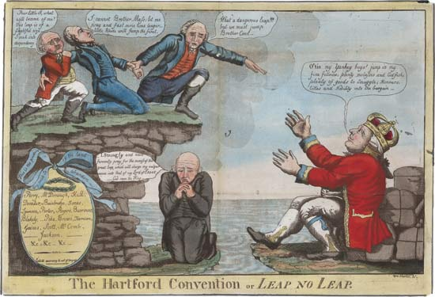
Review
Identify the following image and give the larger significance:
Satire of the Hartford Convention, secret meetings of Federalists held to discuss the embattled New England economy, revising the national compact or pulling out of the republic, that lasted from December 1814 to January 1815. When news arrived of Jackson’s victory in New Orleans and the Treaty of Ghent, the Hartford Convention made the Federalists look wrongheaded, even treasonous. By the 1820s, the party faded from the national scene.

